Slide 1
Reddit scrape & Classification
Erik Green – Data Scientist

Slide 2
Problem statement
After scraping two unique subreddits, can we use Natural Language Processing (NLP) to accurately predict which subreddit the text came from?

Slide 3
Choosing Subreddits
I wanted to choose subreddits that were related, in order to test the limitations of NLP and our models.
Began by scraping the following related subreddits:
Space/Sea
Democrats/Republicans
Showerthoughts/Askscience

Slide 4
Challenges
Many reddit threads begin with a link, video, picture, or meme.
This made it difficult to gather text by scraping the initial posts.
After many scrapes, I continually found that there was not a significant amount of data to work with.
Eventually, decided to scrape the comments section instead, as they were rich in actual text.
Settled on Democrat/Republican comments.

Slide 5
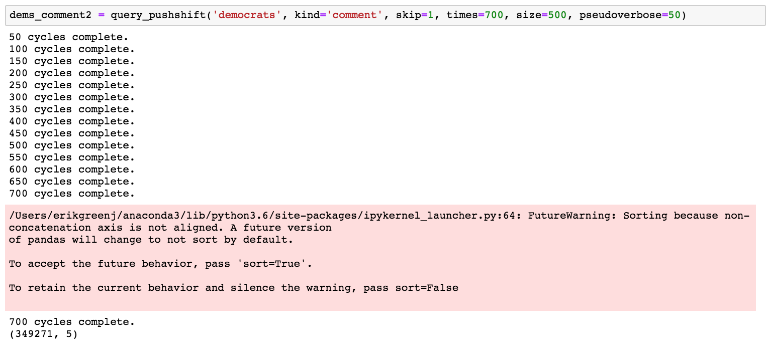
Using a shared function with minimal tweaks, scraped the reddit repository at pushshift.io, and gathered over 300,000 comments for each subreddit.
Scraped 500 comments (the maximum) per day, going back 700 days.
Scrape starts just over a month before the November 2016 elections.
Notes:
-Changes to the function included a way to scrape comments (the fields are different)
-Changed the output to take up less notebook space
-Added a ‘start’ option –thank you Ryan- to pick up where left off.

Slide 6
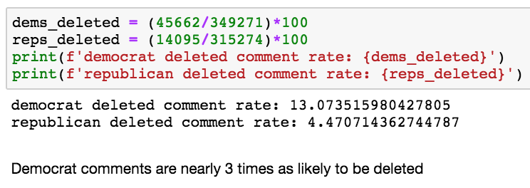
Initial EDA findings
The ‘Democrats’ subreddit is significantly more active than ‘Republicans’
It wasn’t possible to tell exactly how much.
Democrats scrape capped out nearly every day, gettting nearly 350,000 comments
Republican comments equaled 90% of the cap.
Democrat comments were nearly 3 times as likely to be removed.
After dropping these rows, our classes were balanced nearly perfectly, with about 300k each.
Notes:
Note that the scrape doesn’t tell us how many Democrats comments were actually available.

Slide 7
Intermediate Steps
DataFrames were randomly merged
Words from each comment ‘body’ were cleaned.
All symbols and punctuation were removed with Regex
Stop words were removed
All words were converted to lowercase
Words were lemmatized to their root
Words were Vectorized in three ways
CountVectorizer
CountVectorizer with (3,3) n-grams
TF-IDF
Notes:
Term-frequency, inverse document frequency.

Slide 8
Train Test Split
Train Test Split was performed at a 5% train, 95% test ratio.
Train set was still over 30,000 rows.
This served as a good example for ‘real-world’ data science. By training with such a small ratio of the subset, we could better understand how well each model is fit for future posts.
Larger train ratios were difficult to complete a split on.
A data set of this size is hard on a laptop!
The kernel died several times
Notes:
Would like to test with different sizes of t-t-s

Slide 9
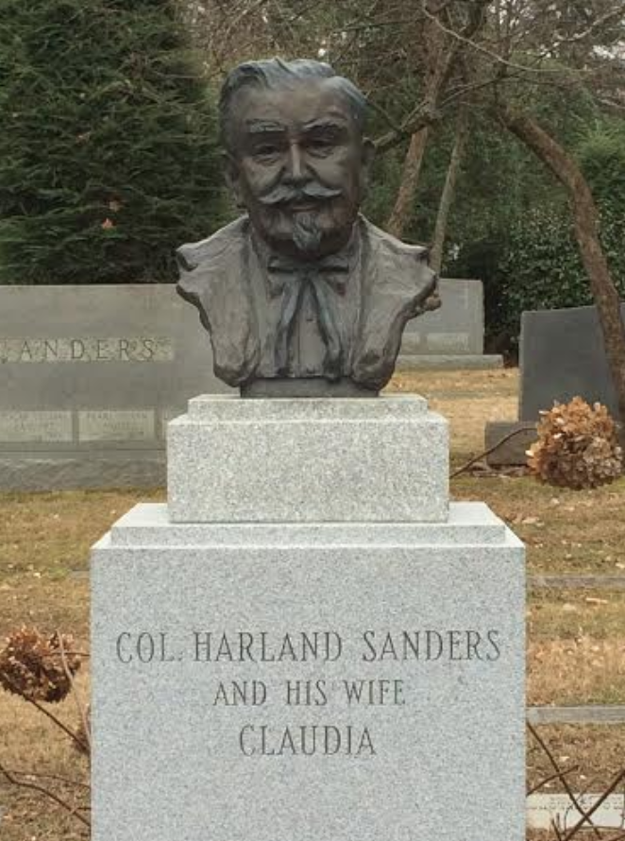
The kernel has died.
Notes:
Colonel Sanders.

Slide 10
Testing
Which model to choose?

Slide 11
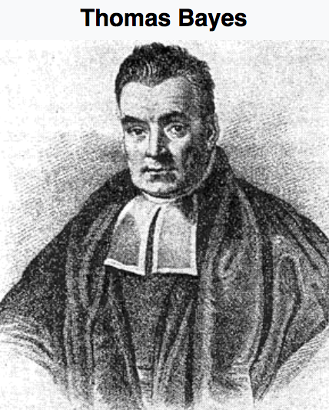
Multinomial Naïve Bayes
Best Train = 0.7233
Best Test = 0.6992
Image courtesy of Wikipedia
alpha = 0.01
Notes:
alpha was the only hyperparam tinkered with.
worked incredibly quickly but results were not good.

Slide 12
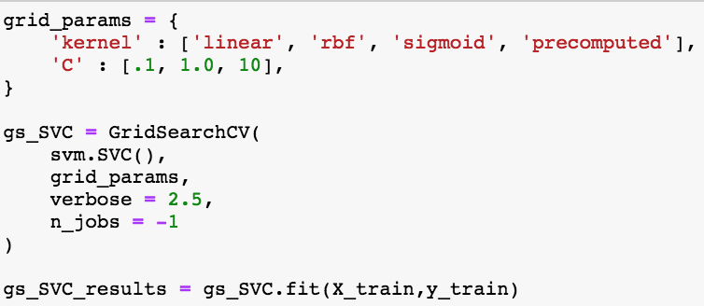
Support Vector Classifier
Best Train = 0.8081
Best Test = 0.7528
C = 0.1, kernel = ‘linear’
’sigmoid’ and ‘rbf’ returned cross validation scores around .50
Notes:
This one may have had potential but was hard on the machine and I was a bit too unfamiliar to tune effectively.

Slide 13

Logistic Regression
Best Train = 0.8825
Best Test = 0.7966
C = 100, solver = ‘newton-cg’, max_iter=10000
Notes:
The high max_iter was necessary because the models were not converging.
Probably because of the massive # of individual words.
This one may have been able to perform better with some more tinkering and a bigger chunk of the train-test set.
Unfortunately, I was afraid to try another train test split, because that’s what kept killing my kernel.

Slide 14
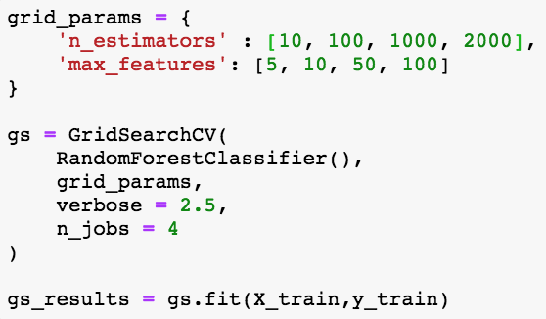
Random Forest Classifier
Best Train = 0.9867
Best Test = 0.9424
n_estimators = 2000, max_features = 5
Notes:
Was run through a GridSearchCV. Performed best with low features and higher estimators.

Slide 15
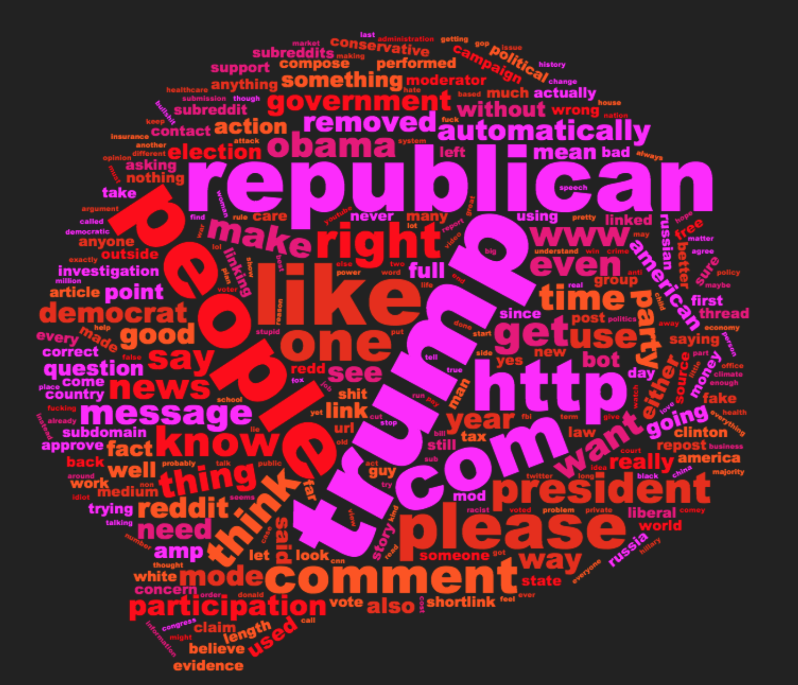
Notes:
This visualization helped me see that if may have been helpful to add a few more stop_words.
mainly http, www, com, like, one

Slide 16
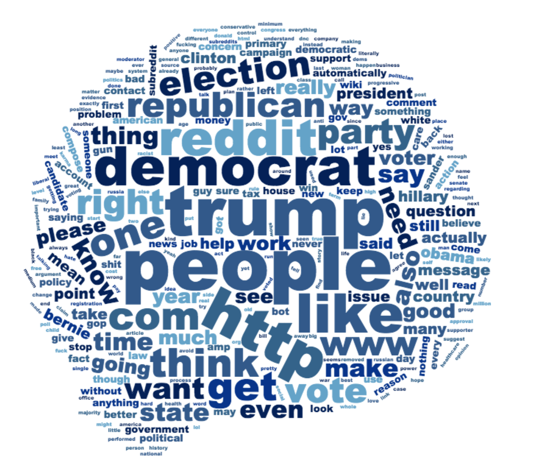
Notes:
These two look so similar. Maybe would be cool to cut out the top 15 words from each?

Slide 17
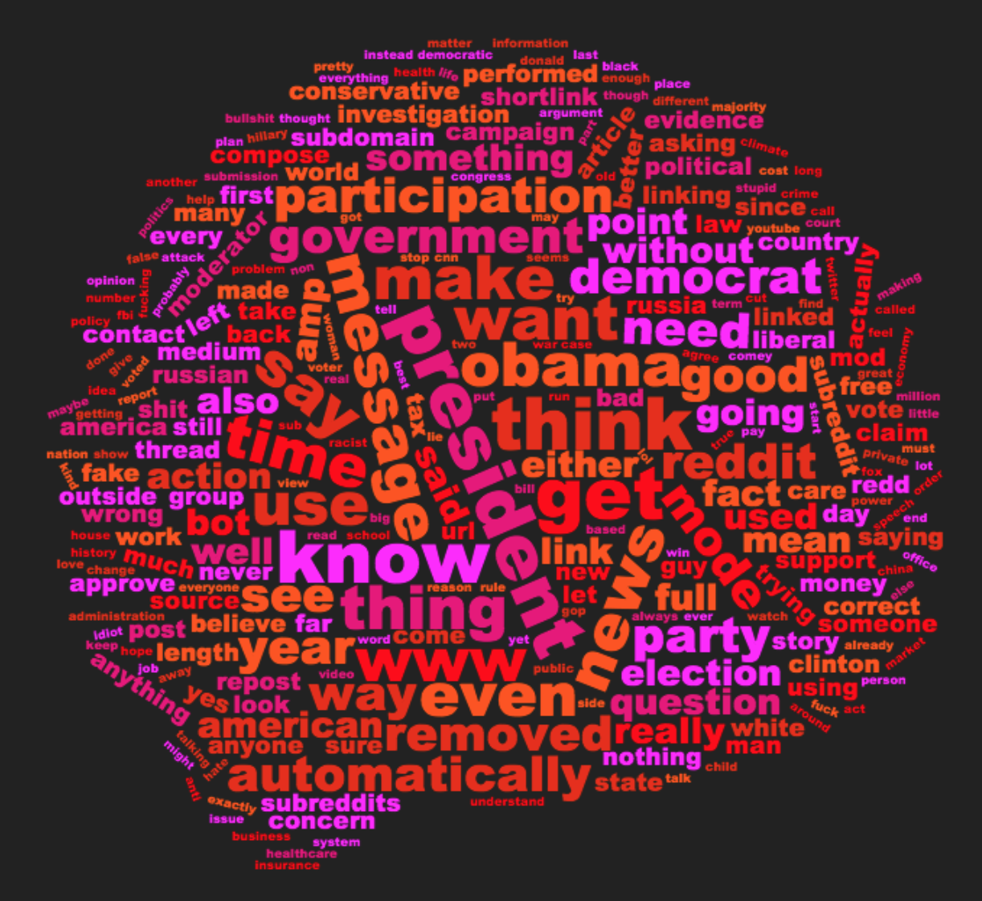
With top 12 words removed
Notes:
Can’t really make any sense of this to be honest.

Slide 18
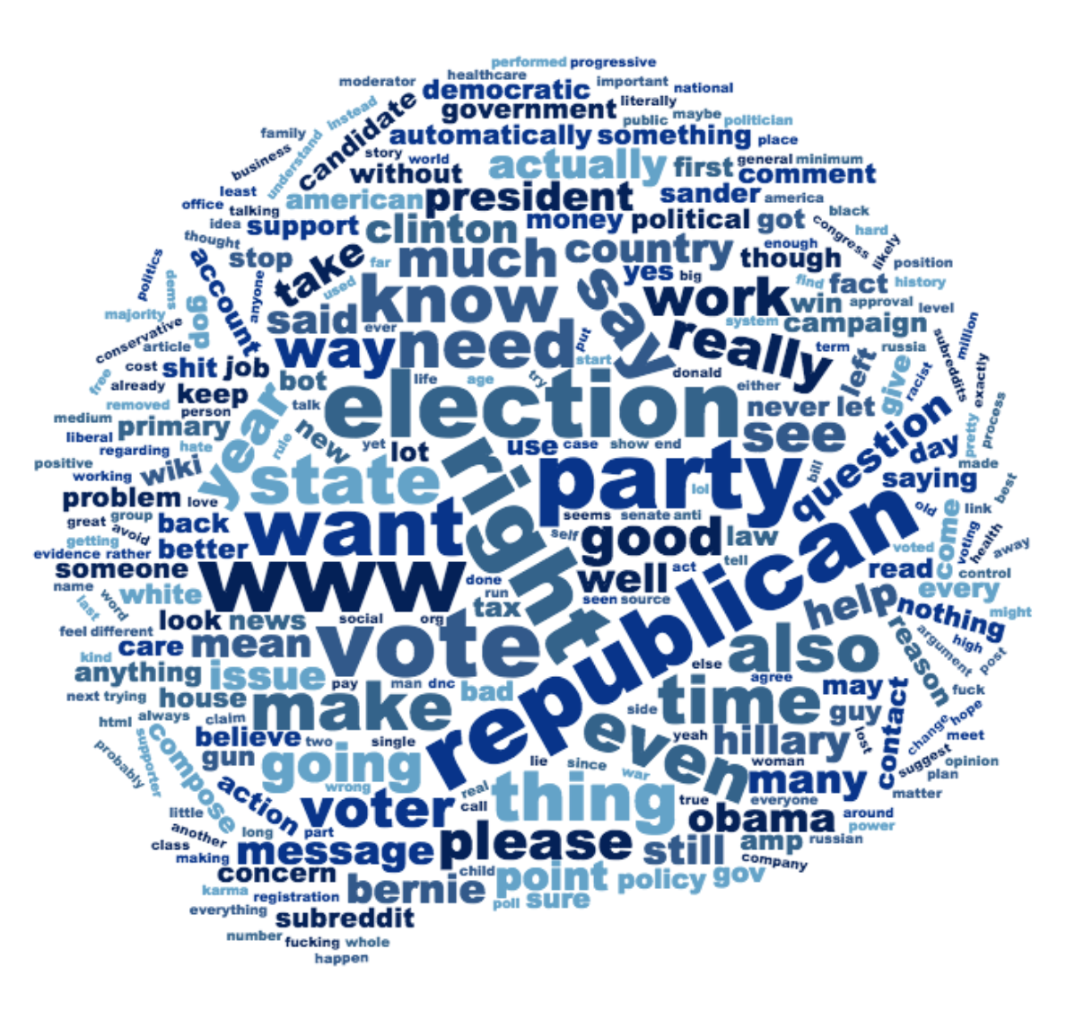
With top 12 words removed

Slide 19
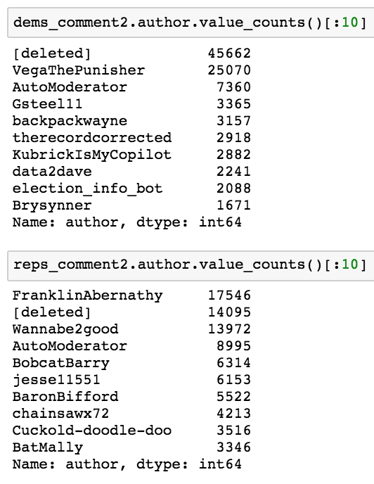
Moving forward
Would like to see results of sentiment analysis based on UTC-timestamp information
Sentiment based on time of day, day of week
Would use AWS to run more models, more vectorizers
It would be interesting to see how these models would perform if the author of each post was used
Notes:
-interested in human behavior

Slide 20
Questions/Comments?

